Slide 1
Fractal implementations

Slide 2
1
What’s a fractal

Slide 3
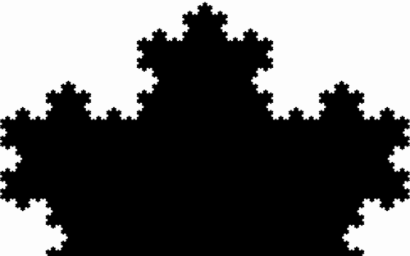
Self-similar fractals
Koch curve

Slide 4
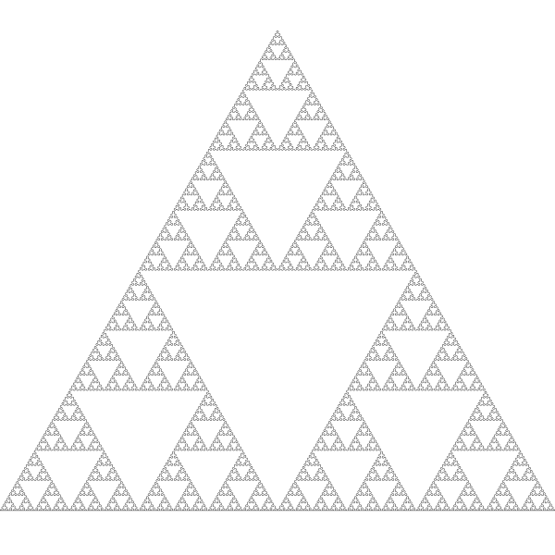
Self-similar fractals
Sierpinski

Slide 5
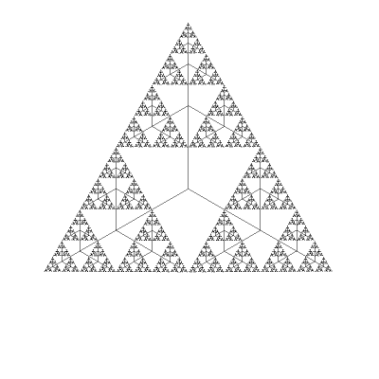
Self-similar fractals
Sierpinski tree

Slide 6
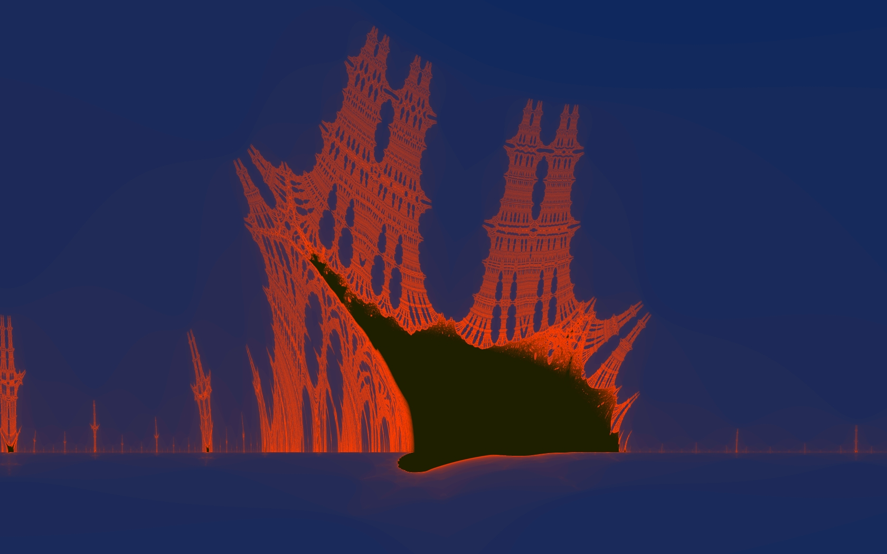
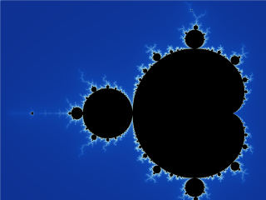
Some fractals are weird
Sierpinski tree

Slide 7
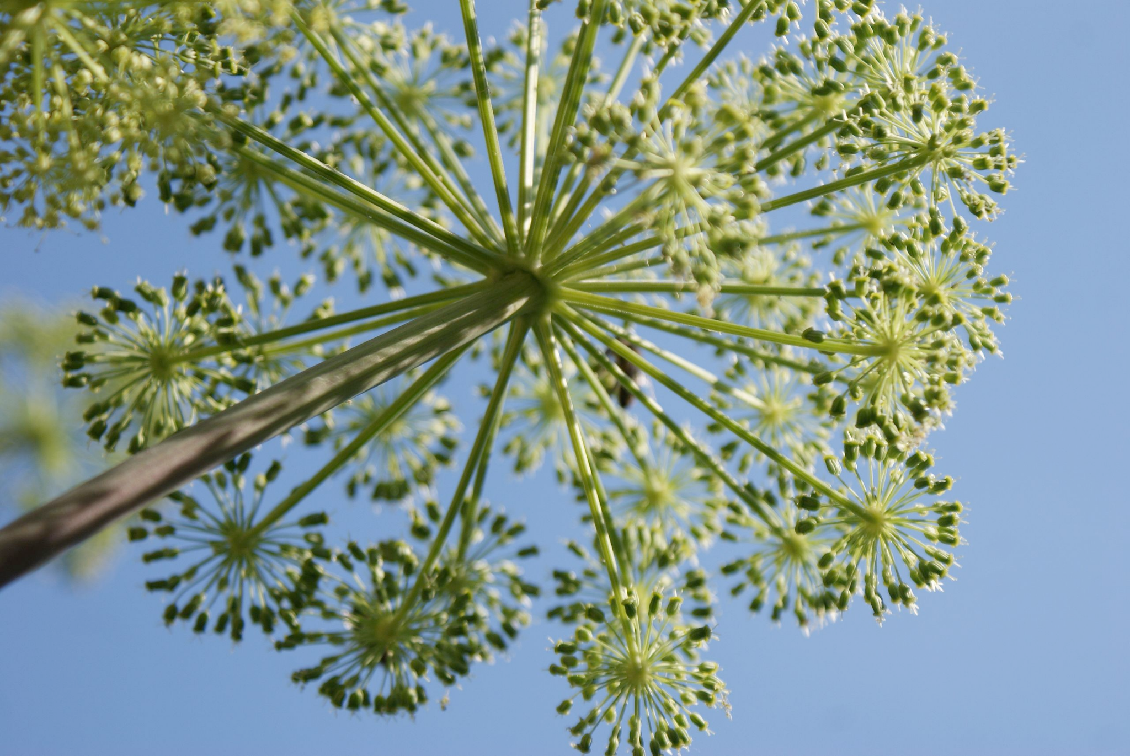
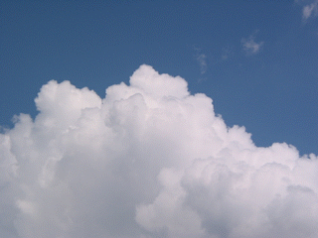
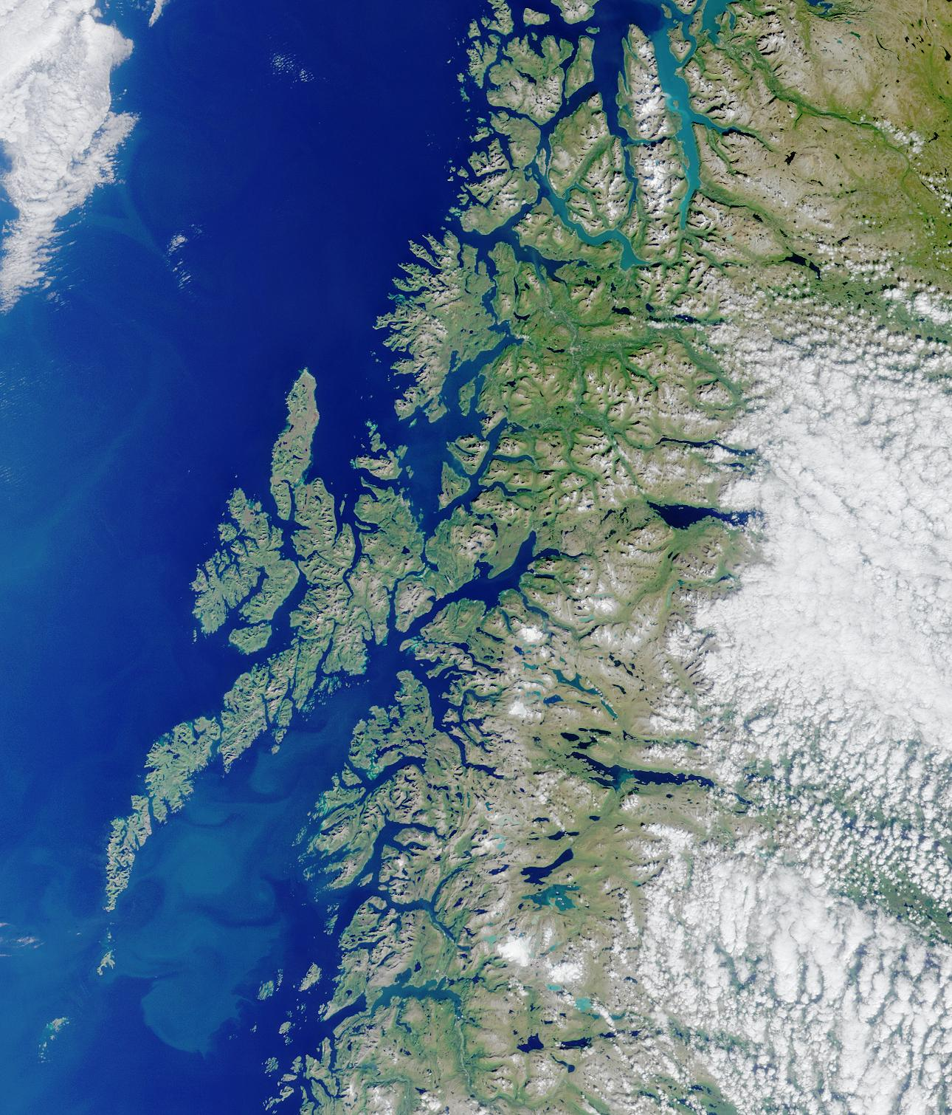
But the world is weird! So that’s good
Notes:
It’s a common misconception that all fractals are self similar

Slide 8
Fractals are shapes with a non-integer dimension.

Slide 9
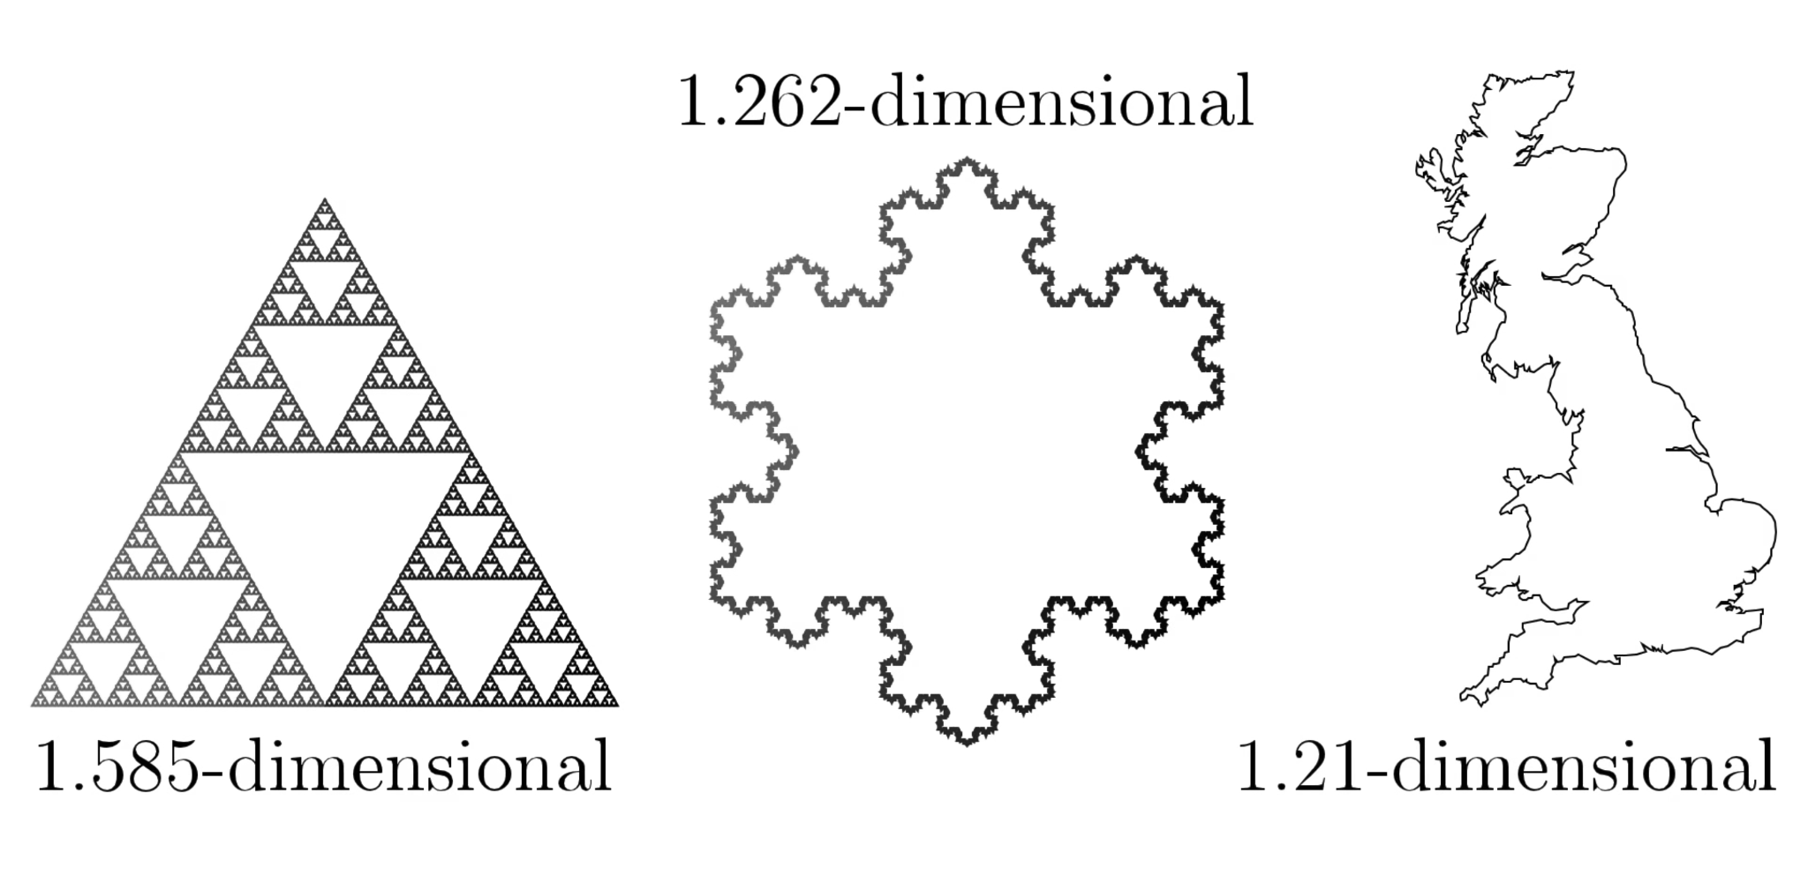
Fractal dimensions
Notes:
In some ways fractal geometry is a rebellion against calculus, that things tends to look smooth if you zoom in far enough. But as we can see from the examples in the past slide, this is not what happens in the real world.

Slide 10
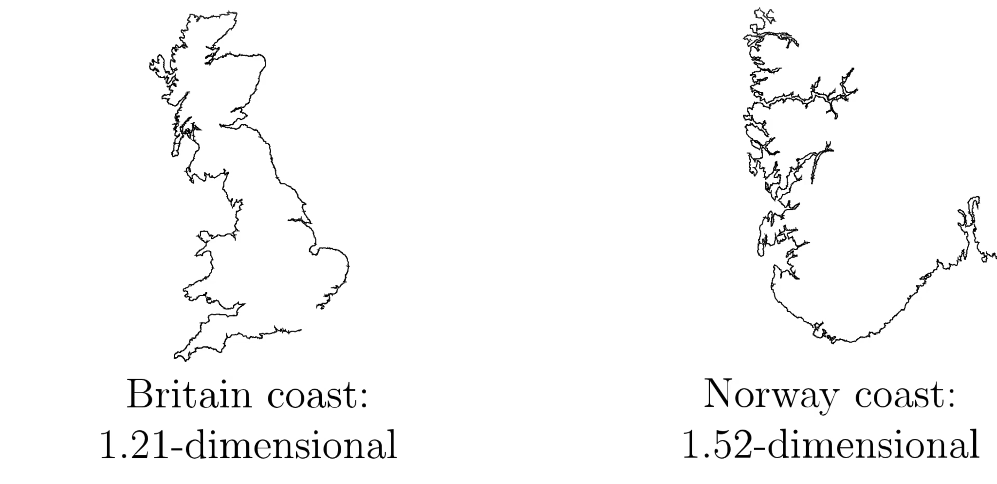
Fractal dimensions
Notes:
In some ways fractal geometry is a rebellion against calculus, that things tends to look smooth if you zoom in far enough. But as we can see from the examples in the past slide, this is not what happens in the real world.

Slide 11

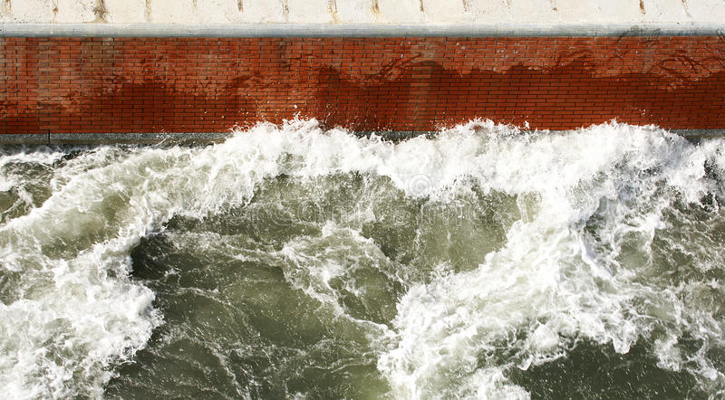
Fractal dimensions
Dimension ~ 2.05 Dimension ~ 2.3
Notes:
In some ways fractal geometry is a rebellion against calculus, that things tends to look smooth if you zoom in far enough. But as we can see from the examples in the past slide, this is not what happens in the real world.

Slide 12
1.1
You don’t have to

Slide 13
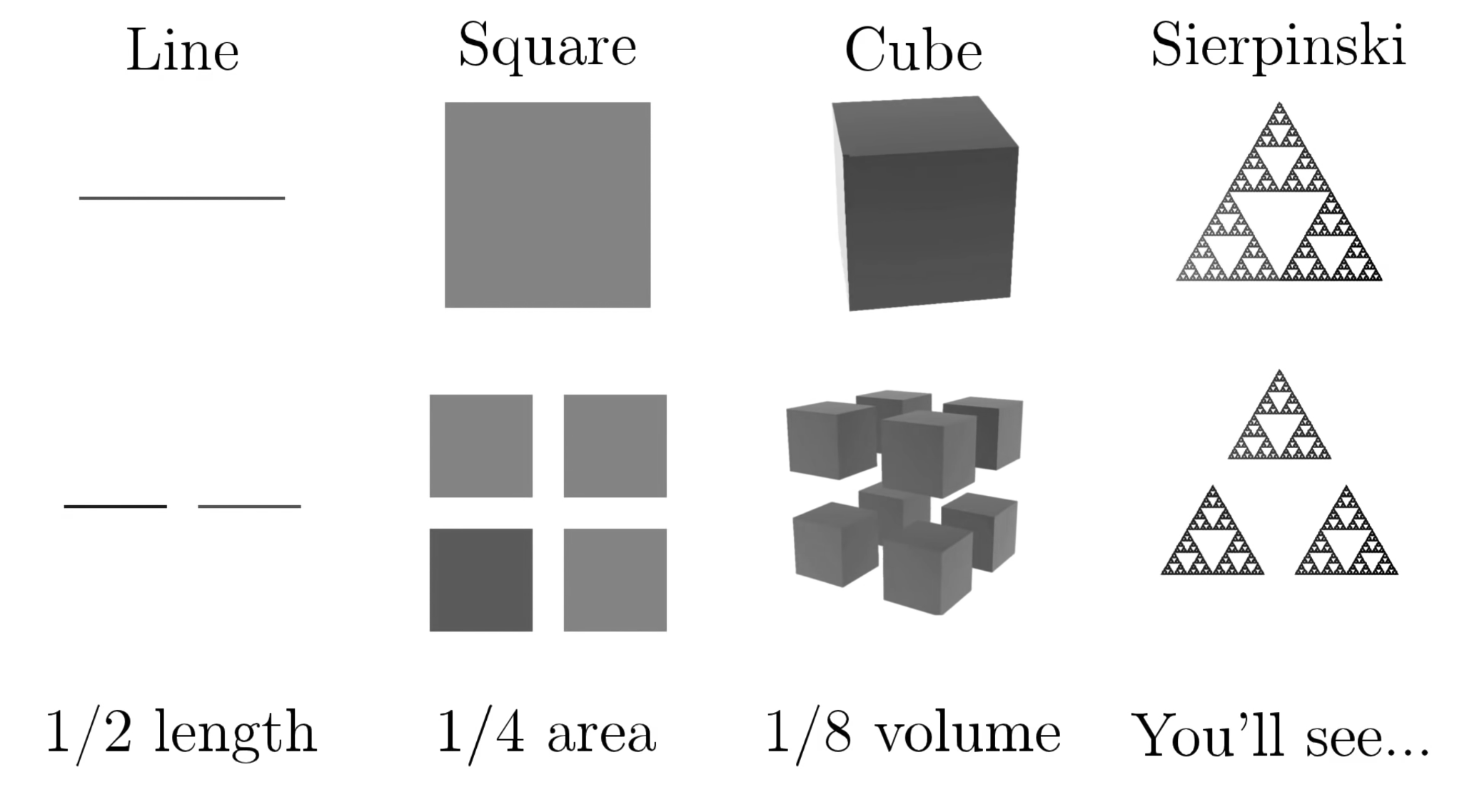
Scaling non-fractal objects
Notes:
In order to understand fractal dimensions we need to understand the concept of scaling things down. We start with simple forms. Don’t worry, all you need to know to understand this is what is a logarithm.

Slide 14
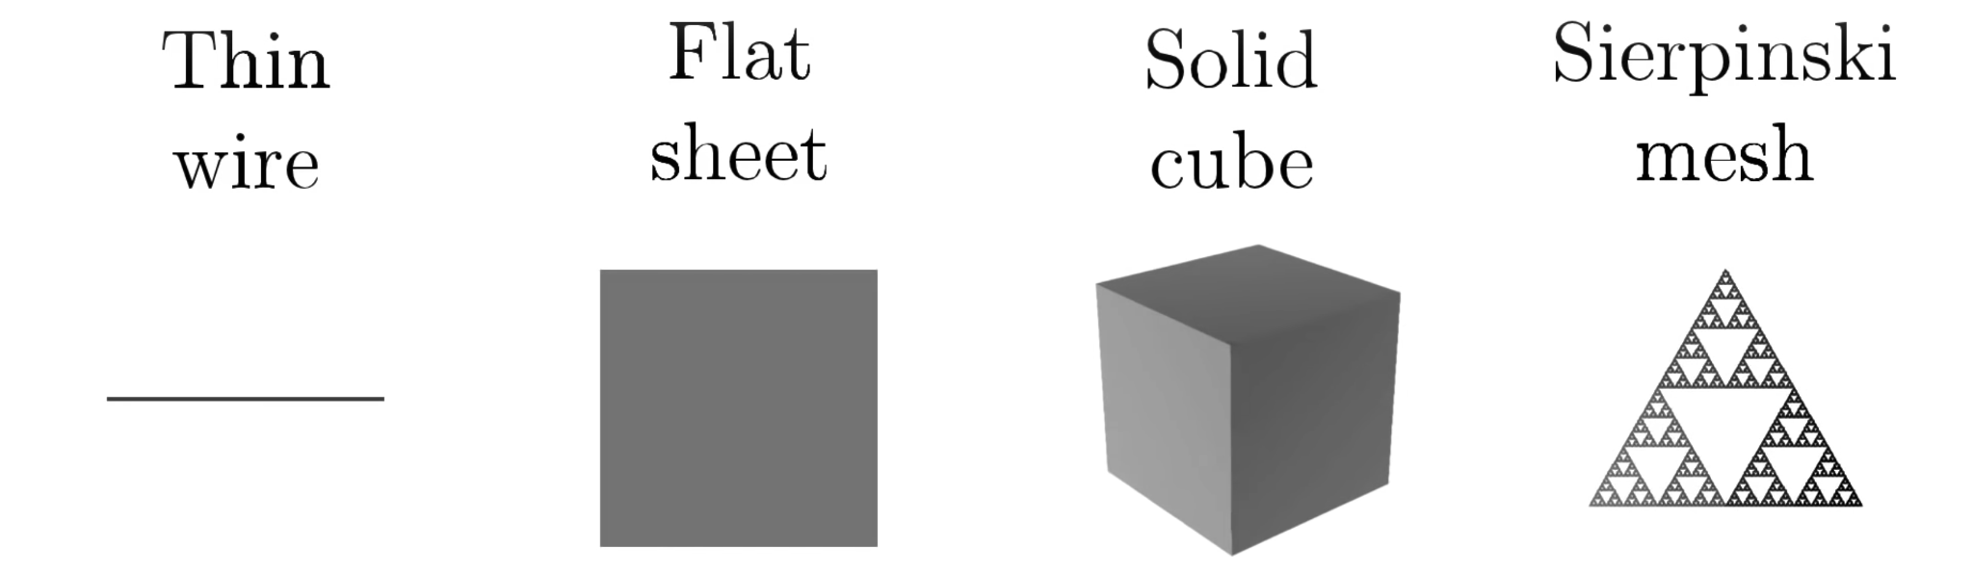
Scaling non-fractal objects
Notes:
For understanding how to scale down objects like a Sierpinski triangle it’s useful to think about these things as if they were real objects and we were scaling their mass down

Slide 15
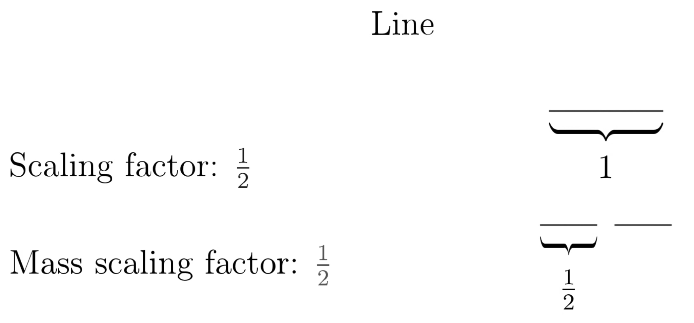
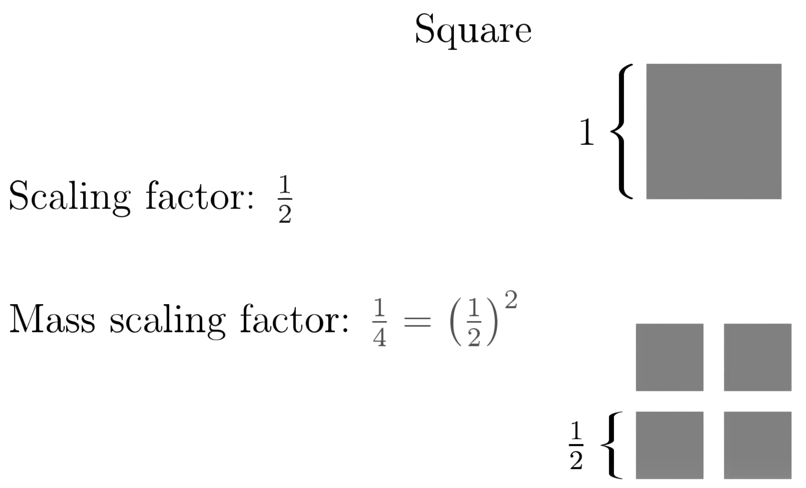
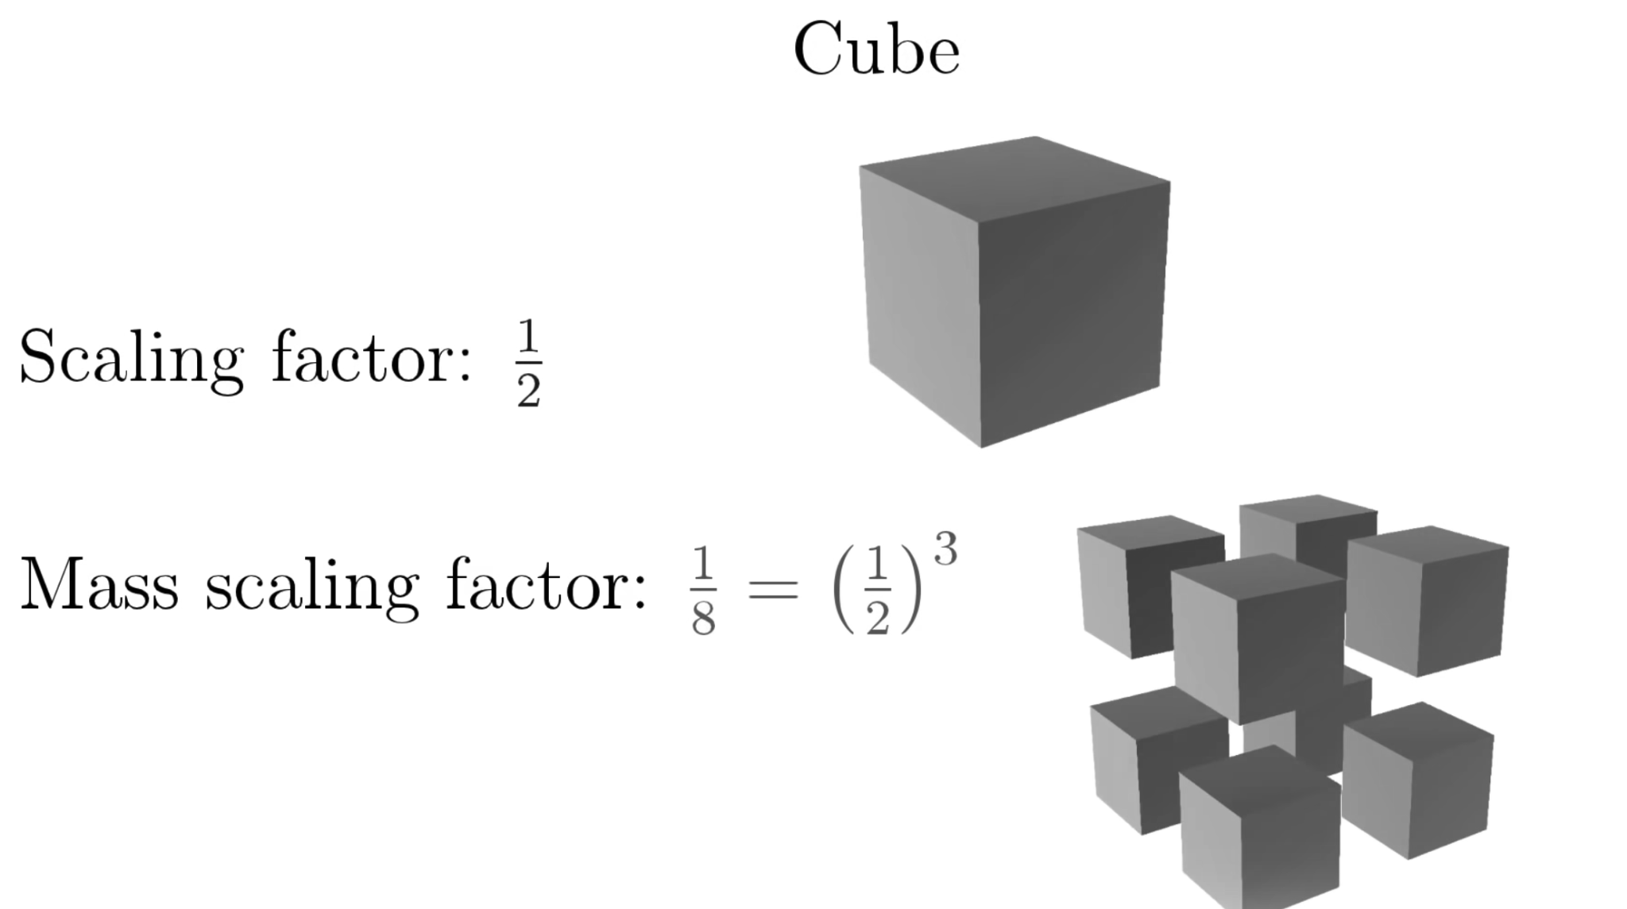
Notes:
As you can see all of the non fractal forms are the scaling factor to a potency. So, if you take the log on the base 2 (because we’re scaling ½) of 2 -> log2(2) = 1, log2(4)=2, log2(8)=3

Slide 16
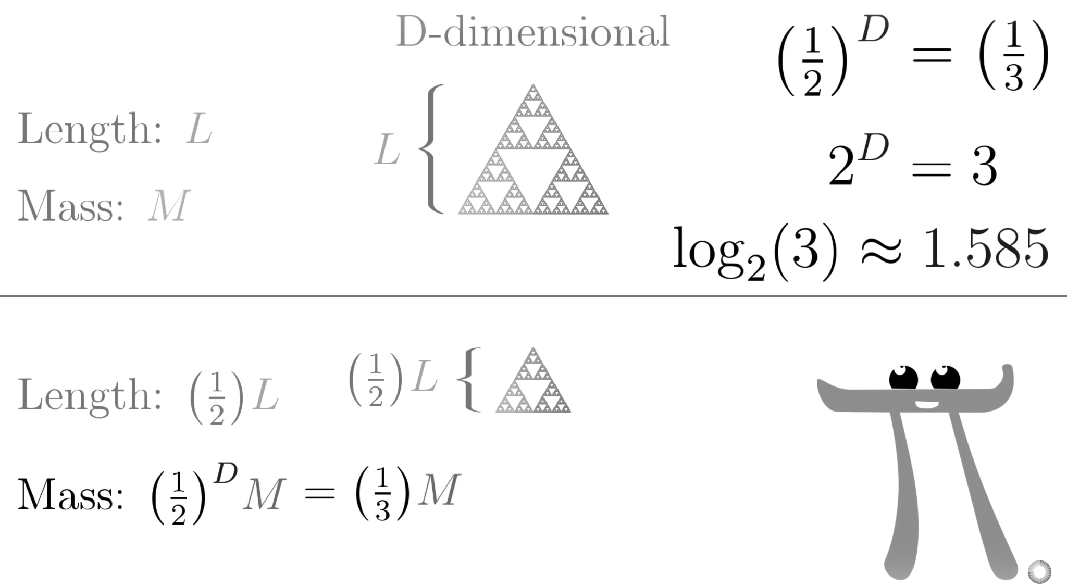
Scaling non-fractal objects

Slide 17
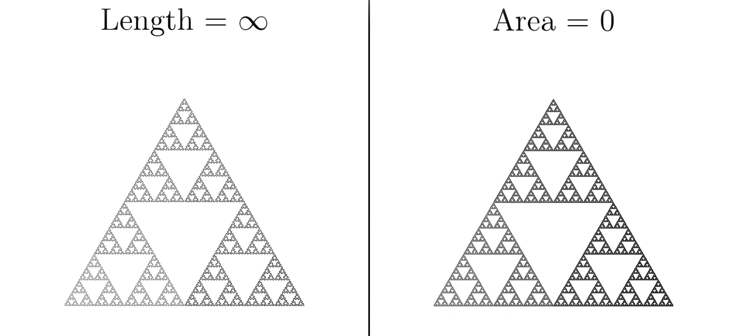
How to measure a fractal?
Notes:
Fractals are hard to put a finger on because they’re weird shapes that fluctuate between the states we usually know. They’re not in the one dimension of a line, but they’re also not the the 2 dimension of a plane. This one specifically is in the 1,585 dimension. So we need a new way to measure a fractal.

Slide 18
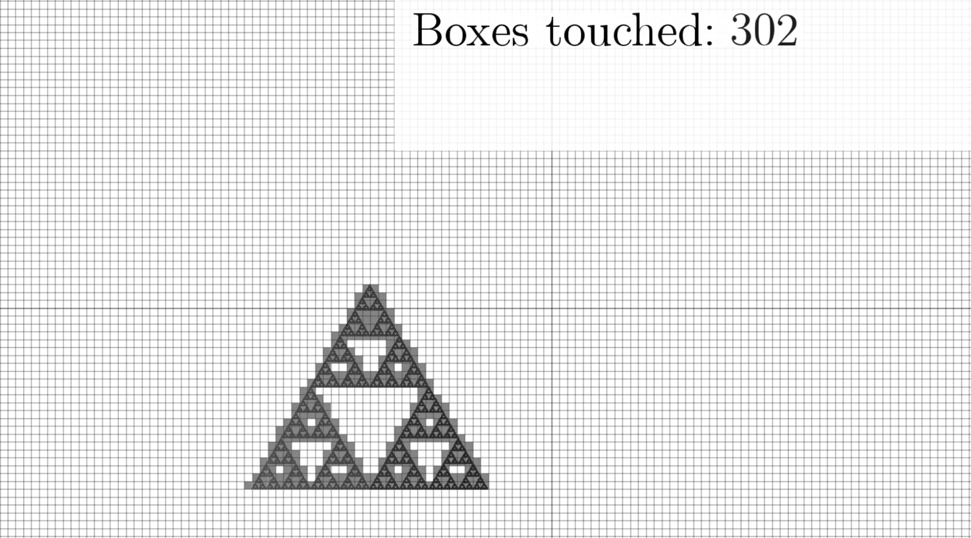
We’re going to count little squares
Notes:
Kind like we’re using calculus

Slide 19
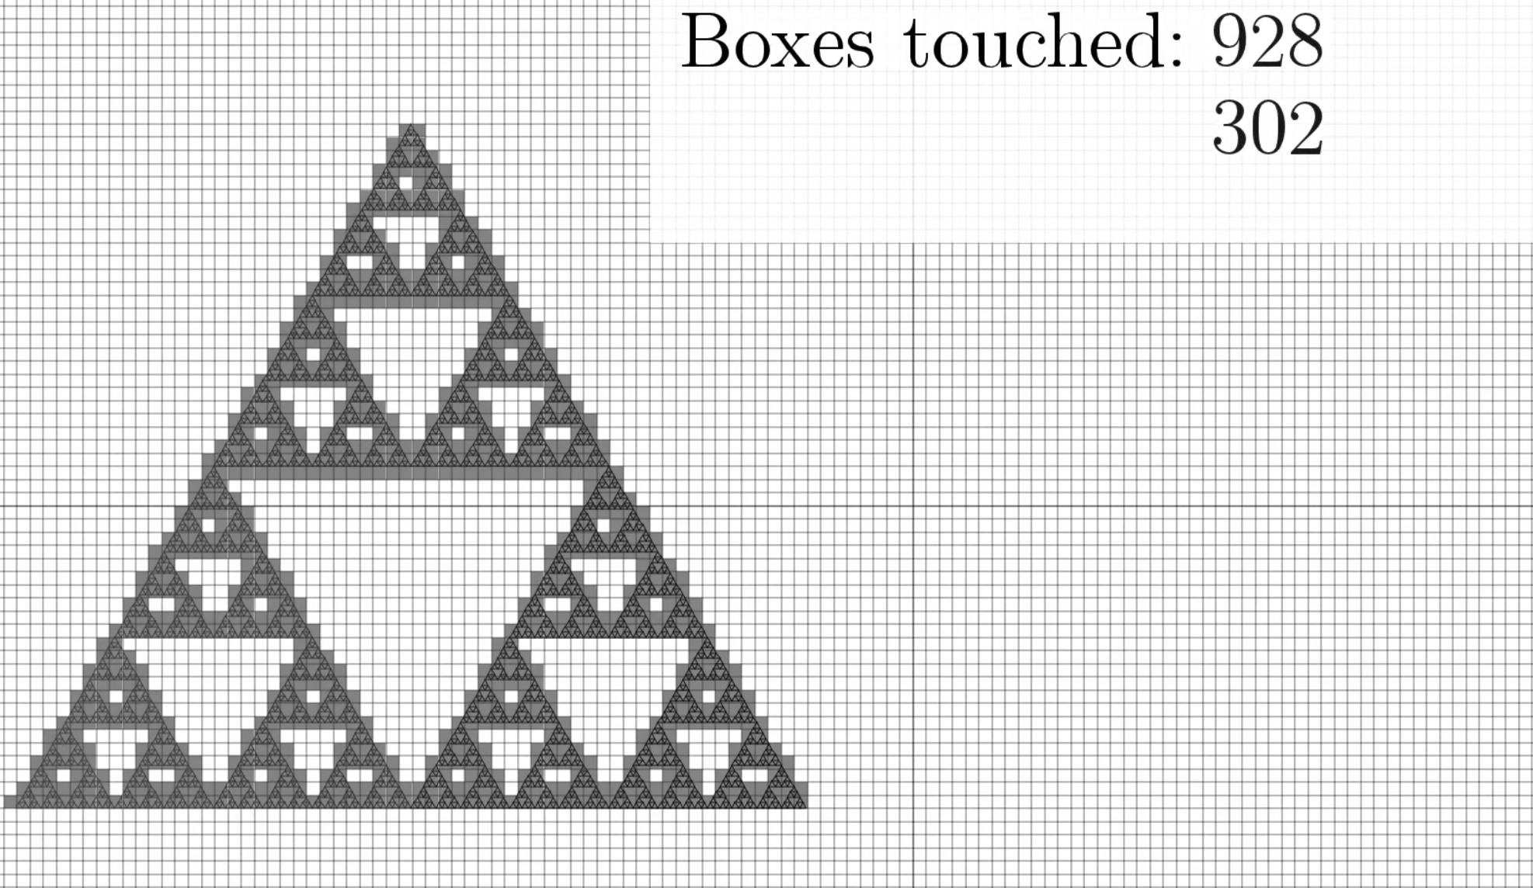
We’re going to count little squares
Notes:
Not that what we’re doing here is exactly what we were doing before. We’re scaling down the

Slide 20
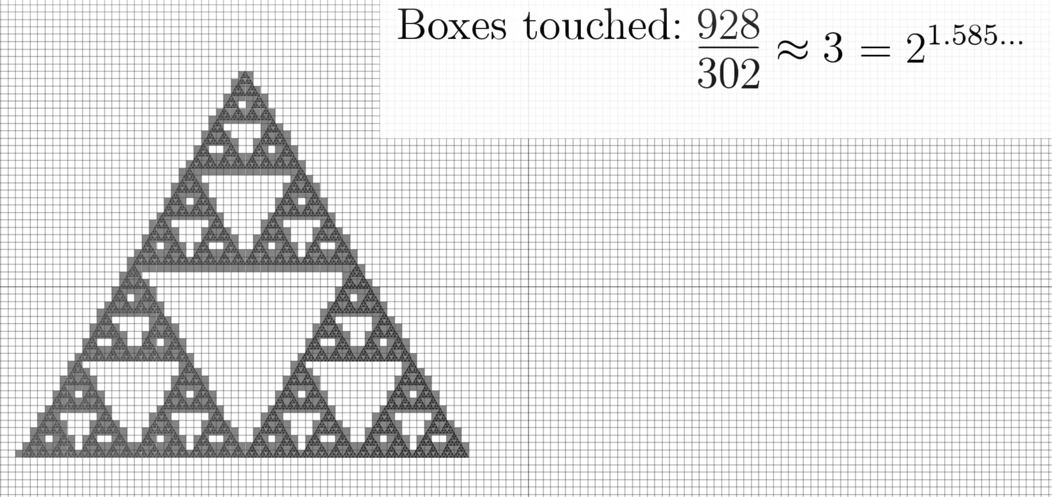
We’re going to count little squares
Notes:
Not that what we’re doing here is exactly what we were doing before. We’re scaling down the

Slide 21
Some shapes are rough and they stay rough, even if you zoom in.

Slide 22
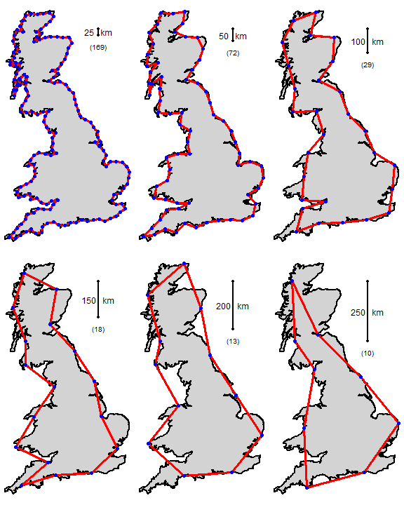
Coastline paradox
Notes:
Not that what we’re doing here is exactly what we were doing before. We’re scaling down the

Slide 23
2
Coding a fractal

Slide 24

Processing
Native to browser (JS)
Established API
Big community
Really good for 2d
Good support for 3d
Easy to start

Slide 25
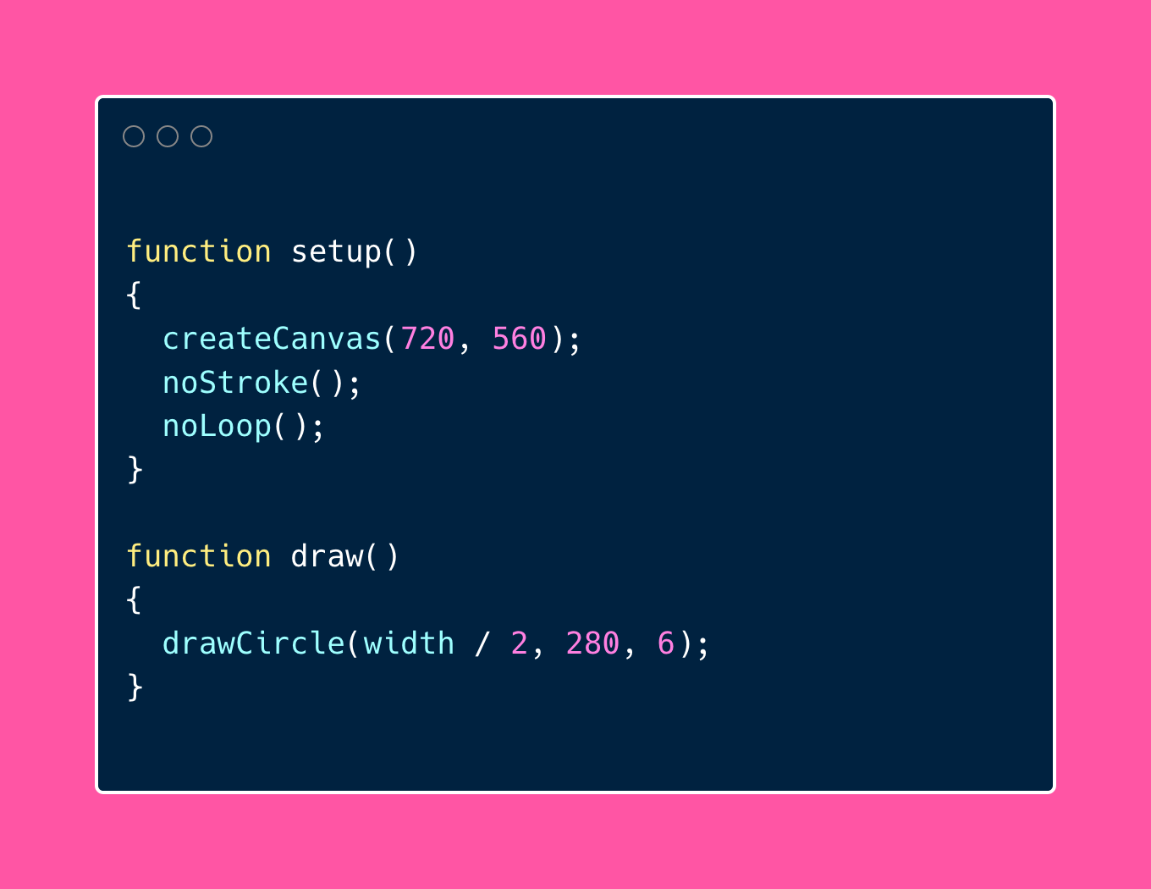
Simple recursion example

Slide 26
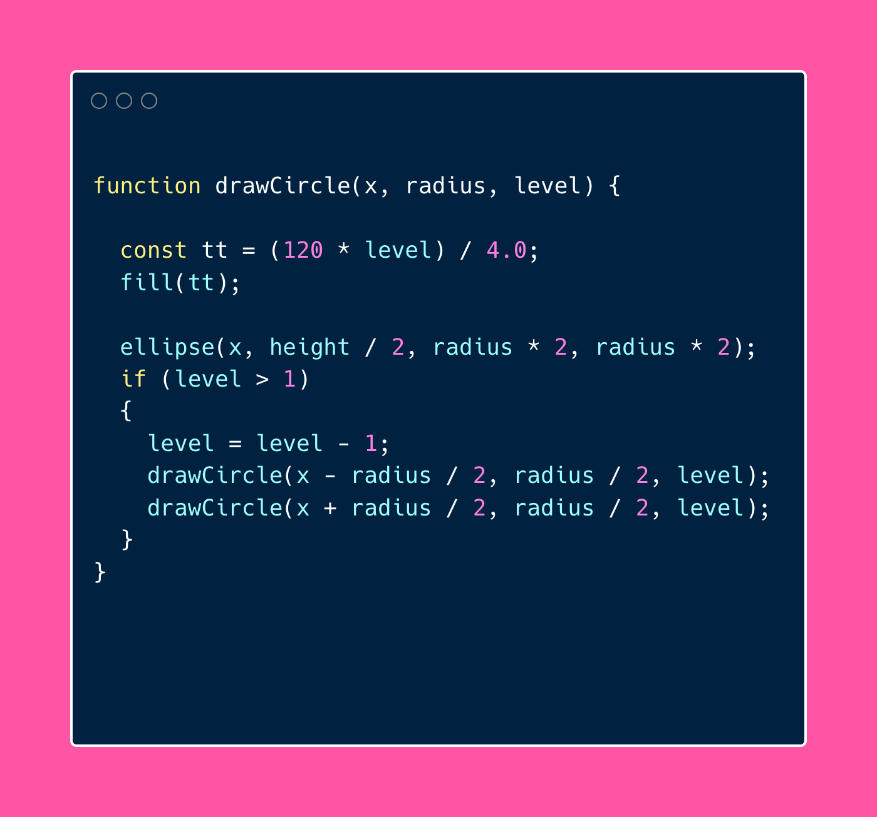
Simple recursion example

Slide 27
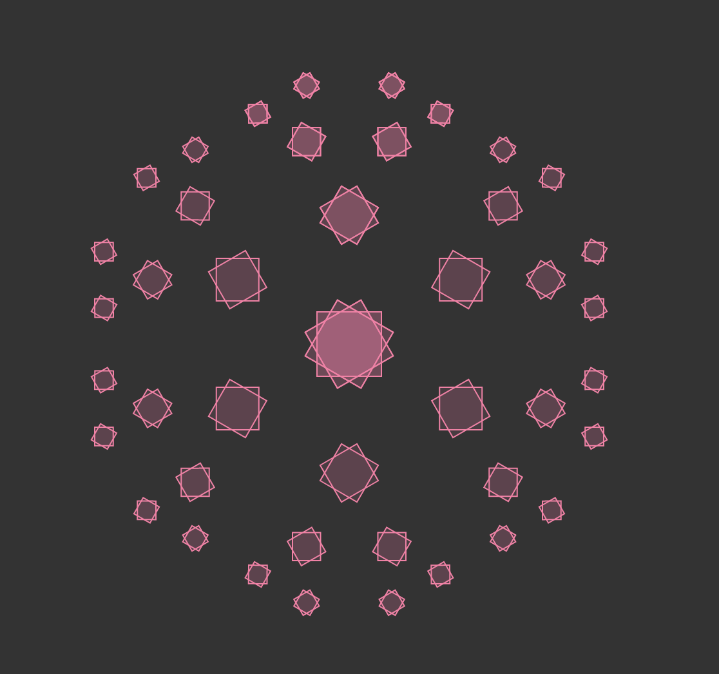
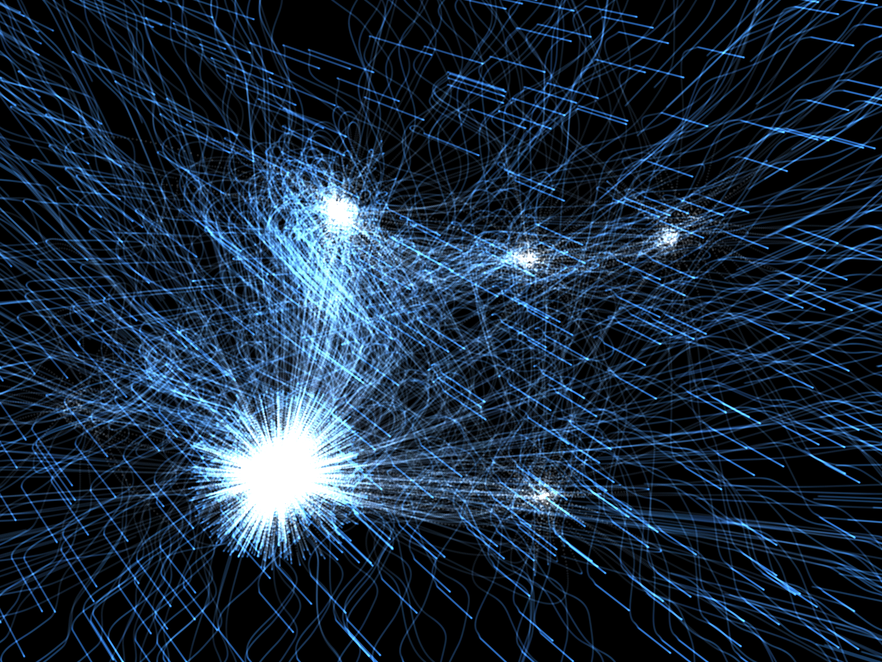
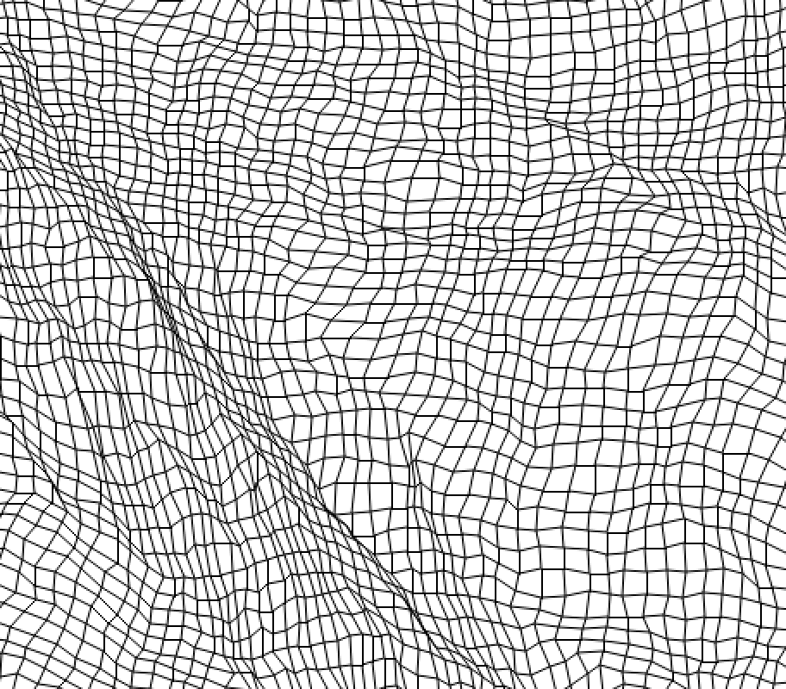
Nice examples
For fractal
Intergalactic
Paper
Dragon fractal

Slide 28
Useful links
Go to: editor.p5js.org
To play with different values with ease
Add it to your webpage: click here!
Templating code to start p5js on your page
Inspiration and examples: click here!

Slide 29
Thanks
Lots of the contents about fractal math comes from: 3b1b
Recursion example by P5js docs
The GIFs are from around the internet and wikipedia (sorry I didn’t find credits for them)

